Slide 1

Android Application Development

Slide 2
Android
Android is a software platform for mobile devices that includes an operating system, middleware and key applications.
Developed by the Open Handset Alliance(consisting of 47 companies to develop open standards for mobile devices)
http://www.openhandsetalliance.com/
Led by Google
Most popular smartphone OS in the U.S.
Over 700,000 devices activated each day

Slide 3
Android Versions
Platform | Codename | API Level
1.5 | Cupcake | 3
1.6 | Donut | 4
2.1 | Éclair | 7
2.2 | Froyo | 8
2.3 2.3.3 | Gingerbread | 9-10
3.0-3.2 | Honeycomb | 11-13
4.0-4.0.3 | Ice Cream Sandwich | 14-15
4.1-4.2 | Jelly Bean | 16-18
4.4 | KitKat | 19-20
5.0 | Lollipop | 21

Slide 4
Android Versions
Platform |  |  | Codename | API Level
Marshmallow | 6.0 – 6.0.1 | October 5, 2015 | 23 | Supported
Nougat | 7.0 – 7.1.1 | August 22, 2016 | 24 – 25 | Supported

Slide 5
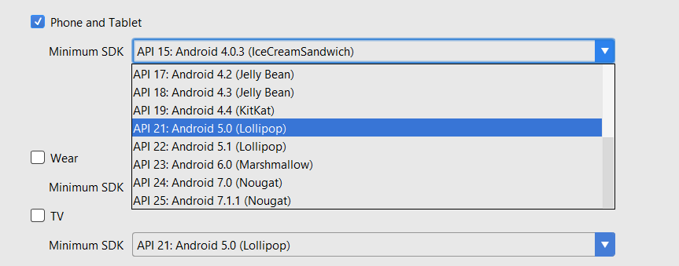
Android Versions

Slide 6
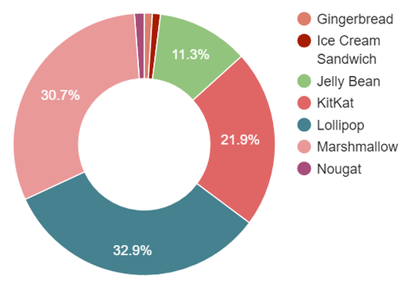
Android Versions

Slide 7




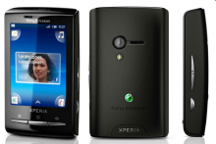


Phones
HTC G1,
Droid,
Tattoo
Motorola Droid (X)
Suno S880
Samsung Galaxy
Sony Ericsson

Slide 8
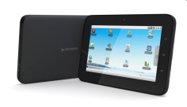
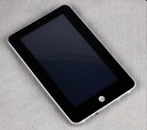
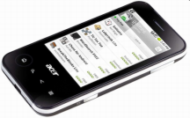
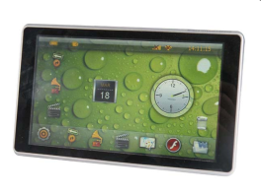


Tablets
Velocity Micro Cruz
Gome FlyTouch
Acer beTouch
Toshiba Android
SmartBook
Cisco Android Tablet
Dawa D7

Slide 9
Android UI
Major UI Components for Jelly Bean (Ice Cream Sandwich)
Buttons
Back
Home
Recent
Action Bar
Notifications
App drawer
Android UI allows
Customizable home screens
Widgets

Slide 10
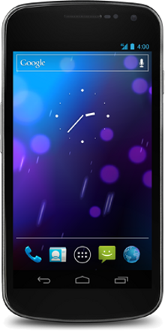
Home Screen
App Shortcuts
Folders
Widgets
Favorites Tray

Slide 11
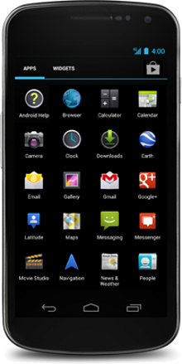
All Apps Screen
Browse through all applications and Widgets
Drag apps or widgets to home screen

Slide 12
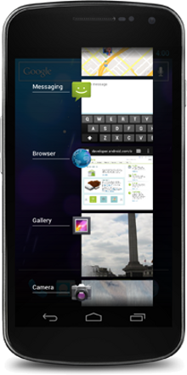
Recent Apps
Allows for easy application switching
Apps are shown in reverse chronological order
Remove an app by swiping
Launch using Recents button

Slide 13
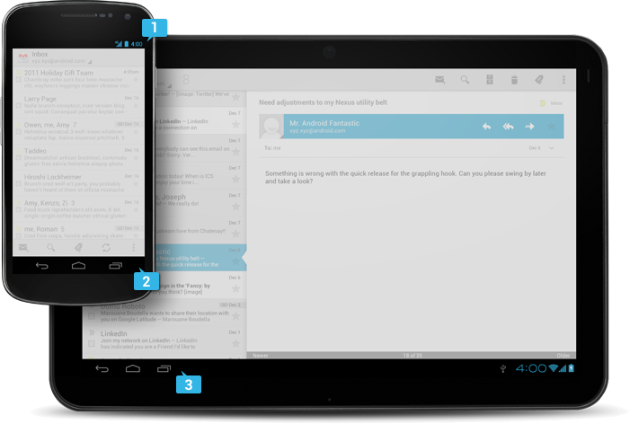
System Bars
Status Bar
Combined (Tablets Only)
Navigation
Bar

Slide 14
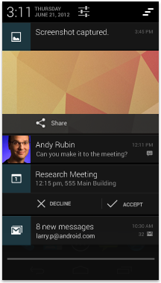
Notifications
Notifications are revealed by swiping up on the status bar
Touching a notification opens the app
Swiping a notification left or right removes it

Slide 15
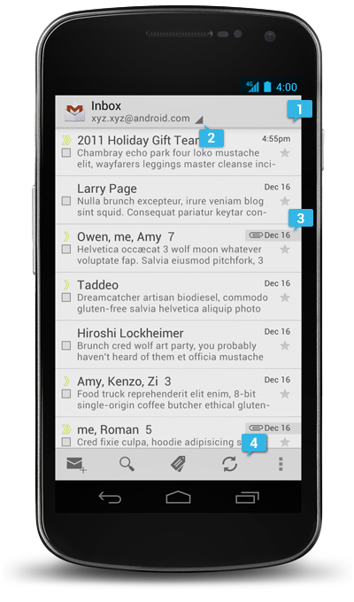
Common App UI
Main Action Bar
View Control
Content Area
Split Action Bar

Slide 16
Hardware Differences
Different platforms
Handsets
Tablets
Screens
Technologies (TFT LEDs, AMOLED, etc.)
Sizes (small, normal, large)
Pixel densities (low, medium, high)

Slide 17
User Input Methods
Touch
Touch
Double tap
Long press
Drag
Fling
Pinch zoom
Keyboard

Slide 18
Android Features

Slide 19
Architecture
Kernel based on the Linux kernel
Middleware, libraries written in C/C++
APIs and application software written in Java

Slide 20
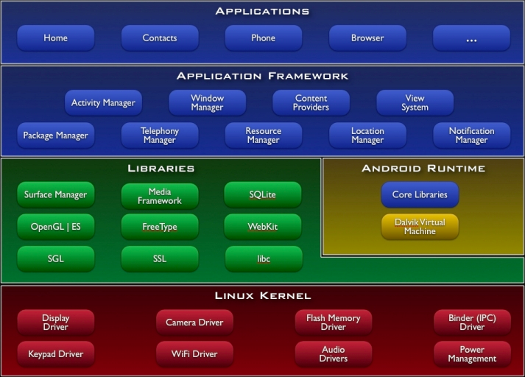
Architecture

Slide 21
Applications
Android devices ship with basic applications such as sms, email, calendar, browser, contacts, etc.
Applications are written in Java

Slide 22
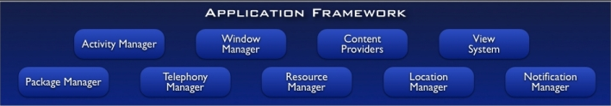
Application Framework
Feature | Role
View System | Used to build an application, including lists, grids, text boxes, buttons, and embedded web browser
Content Provider | Enabling applications to access data from other applications or to share their own data
Resource Manager | Providing access to non-code resources (localized strings, graphics, and layout files)
Notification Manager | Enabling all applications to display customer alerts in the status bar
Activity Manager | Managing the lifecycle of applications

Slide 23
Application Framework
Developers have full access to the same framework APIs used by the core applications.
Focuses on reuse; any application can publish its capabilities and any other application may then make use of those capabilities
Allows components to be replaced by the user.

Slide 24
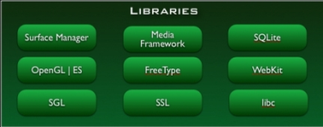
Libraries
Android includes a set of C/C++ libraries used by various components of the Android system.
These capabilities are exposed to developers through the Android application framework.

Slide 25
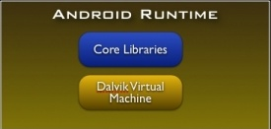
Android Runtime
Android includes a set of core libraries that provides most of the functionality available in the core libraries of Java
Data Structures
Utilities
File Access
Network Access
Graphics
Etc
Every Android application runs in its own process, with its own instance of the Dalvik virtual machine (Prior to Android version 5.0 (API level 21)).

Slide 26
Dalvik Virtual Machine
Even though most Android applications are written in Java, there is no JVM in the platform
Java byte code is not executed
Java classes are compiled into Dalvik executables and run on Dalvik
Code is converted from .class files to .dex files

Slide 27
Dalvik Virtual Machine
Dalvik is a specialized virtual machine designed specifically for Android
Optimized for battery-powered mobile devices with limited memory and CPU
The Dalvik VM relies on the Linux kernel for underlying functionality such as threading and low-level memory management

Slide 28
Android version 5.0 (API level 21) or higher,
each app runs in its own process and with its own instance of the Android Runtime (ART).
ART is written to run multiple virtual machines on low-memory devices by executing DEX files
a bytecode format designed specially for Android that's optimized for minimal memory footprint
compile Java sources into DEX bytecode

Slide 29
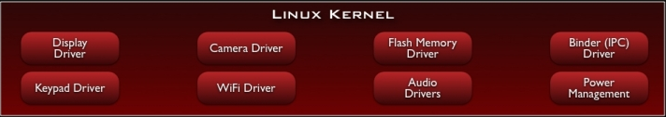
Linux Kernel
Android relies on a Linux kernel for core system services
security
memory management
process management
network stack
The kernel also acts as an abstraction layer between the hardware and the rest of the software stack.

Slide 30
Distributing Applications

Slide 31
Google Play Store
Applications can be purchased and downloaded from the Google Play Store https://play.google.com/store
To publish software in the Google Play Store, you must do three things:
Register
Pay a fee ($25)
Agree to the Android Market Developer Distribution Agreement

Slide 32
Building Good Apps
Entertaining
Fulfill a need
Or write an app that improves on existing solutions
Update frequently
Works properly
Intuitive
Quality graphics, images, audio and video

Slide 33
Android Best Practices
http://developer.android.com/guide/practices/index.html

Slide 34
Object Oriented Programming

Slide 35
Classes
Classes are blueprints that represent objects
Must instantiate the object to use it
Classes encapsulate
Object attributes (instance variables)
Object behaviors (methods)
Methods tell an object to perform a task

Slide 36
Inheritance
Create new objects by extending an existing object
Add new attributes
Add new methods
Override existing methods

Slide 37
Reading homework
Android Development Introduction: p1-27

